Slide 1


Welcome
To the [network name] Network meeting:
[meeting title]

Slide 2

Housekeeping
Anything relevant to the physical space (e.g. toilets, catering..)

Slide 3
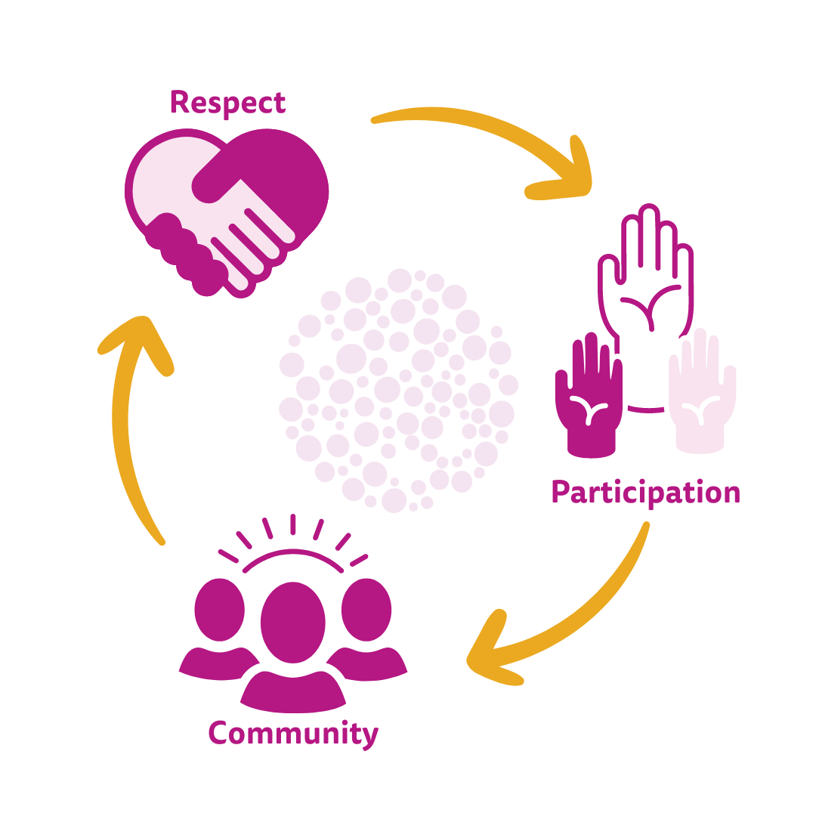
MHPN Member Expectations
All members should demonstrate respect for other members, the Coordinator and any external guest speakers or organisations at the meeting.
All interactions must be free from discrimination, harassment and bullying.
Recognise the thoughts, feelings, and backgrounds of others are as important as one’s own.
Represent yourself in a true and accurate manner.
All members should strive to actively participate both in their network generally and during meetings.
Actively engage in discussions.
Follow all ground rules.
Help your Coordinator who volunteers their time to organise these meetings.
Follow prompts and participate as asked by your Coordinator or guest presenter.

Slide 4
Ground Rules
To help ensure everyone can gain the most from the meeting, we ask that all participants consider the following ground rules:
Be respectful of other participants and guest speaker/s.
More ground rules…

Slide 5
Agenda
Item 1
Item 2
…

Slide 6
Content Slide Title (Text)
Content copy

Slide 7
Content Slide Title (Text + Image)
Content copy
Image

Slide 8
Content Slide Title (Large Image)
Content copy
Image

Slide 9
Network Directories
Connect with network members outside of this meeting by opting-in for the exclusive MHPN Network directory!
Share your details with other members of this network to connect beyond meetings.
Improve your own referral pathways by having access to the directory.
Please note, You won’t appear on the directory until you have attended your first network meeting and your attendance has been processed by the MHPN admin team. This can take a few weeks.

Slide 10
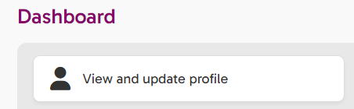

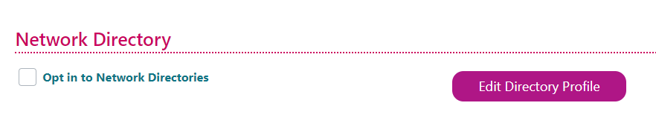
Network Directories
To opt-in, sign consent on the attendance sheet during the meeting,
OR
Log in to you MHPN Portal Account, navigate to the ‘Personal Details’ Tab and scroll to ‘Network Directory’, then check the opt-in box.

Slide 11
Thank you for attending!
Learn more at www.mhpn.org.au

